Slide 1
Retrieving Documents With Mathematical Content
Date : 2014/06/10
Author :Shahab Kamali
Frank Wm. Tompa
Source : SIGIR’13
Advisor : Jia-ling Koh
Speaker : Shao-Chun Peng

Slide 2
Outline
Introduction
mathematical expressions
Related Work
Purpose
Methods
Experiments
Conclusions

Slide 3
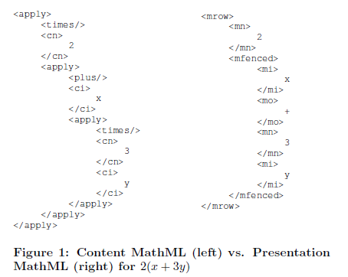
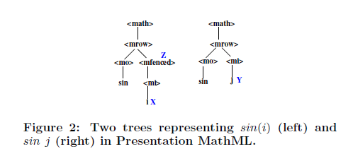
Introduction
Mathematical expressions(context-dependent rules)
Content-based
Presentation-based
Dom Tree

Slide 4
Introduction
Mathematical expressions: complex structures and rather few distinct symbols
$\sum_{i=1}^{n}{i}$ and $\sum_{j=1}^{m}{j}$ are similar?
$2^{n}$ and $n^{2}$ are similar?
Motivation
keyword search only cannot fully exploit their mathematical information.

Slide 5
Related Work(Exact match)
TextSearch
Bags of words
Exact Match
tree
very limited variation among the expressions returned
NormalizedExactMatch algorithms
ignore specic numbers, variables, and operators by removing all leaf nodes
$\frac{1}{X^{2}+1}$ and $\frac{1}{X^{2}+a}$ are same?

Slide 6
Related Work(Approximate match)
SubexprExactMatch
at least one of its subexpressions exactly matches the query
some structure information is missed by transforming an expression into bags of tokens
NormalizedSubExactMatch
one of its normalized subexpressions matches the normalized query
performance remains relatively poor

Slide 7
Related Work(Approximate match)
MIaS
subtrees are normalized and transformed into tokens and a text search engine is used to index and retrieve them

Slide 8
Purpose
Mathematical Expression
its appearance(or presentation)
its mathematical meaning (often termed its content)
how to capture the relevance of mathematical expressions, how to query them, and how to evaluate the results

Slide 9
Outline
Introduction
Methods
SIMILARITY SEARCH
PATTERN SEARCH
Experiments
Conclusions

Slide 10
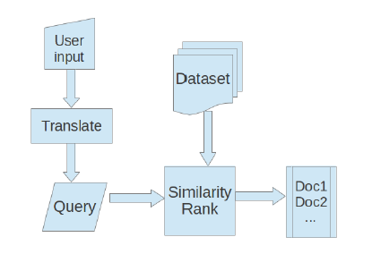
SIMILARITY SEARCH
Translate
translated input into Presentation MathML
Similarity
based on tree edit distance

Slide 11
Tree Edit
T1 = (V1;E1) T2 = (V2;E2)
τ is a sequence of edit operations that transforms T1 to T2
dist(T1; T2) = min {cost(τ)|τ (T1) = T2}
E1 and E2 represented by trees T1 and T2.

Slide 12
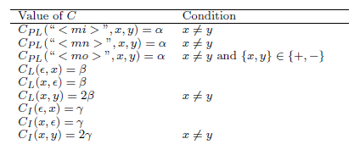
Tree Edit(cost)
If λ(N1) = λ(N2) then cost(N1→N2) = 0
If N1, N2 are leaf nodes and λ(N1) ≠ λ(N2) and λ(parent(N1)) = λ(parent(N2)), cost(N1→N2) =CPL(λ(parent(N1)); λ(N1); λ(N2))
mi
mi
N2
N1
i
j
i
Cost=α

Slide 13
Tree Edit(cost)
If N1, N2 are leaf nodes and λ(N1) ≠ λ(N2) and λ(parent(N1)) ≠ λ(parent(N2)) then cost(N1→N2) =CL(λ(N1) ; λ(N2) )
If N1, N2 are not both leaf nodes and λ(N1) ≠ λ(N2) then cost(N1 → N2) = CI (λ(N1); λ(N2))
mi
mn
mi
N2
N1
x
x
3
Cost=2β

Slide 14
cost
α<=β<=γ
X+2 and X+1 are different with cost α
X+2 and X+Y are different with cost β
X+2 and X+E are different with cost γ(E is a expression)

Slide 15
Tree Edit(cost)
Cost=α+β

Slide 16
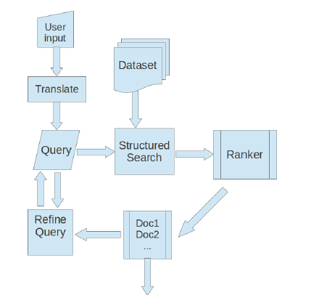
PATTERN SEARCH
Translate:
wild card
Ranker
sort results with respect to the sizes of the matched expressions in increasing order.

Slide 17
PATTERN SEARCH
a template can be defined using wildcards as non-terminals,and regular expressions to describe their relationships
Number wild cards ,Variable wild cards, Operator wild cards

Slide 18
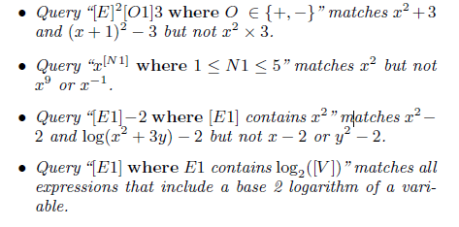
wild cards(example)

Slide 19
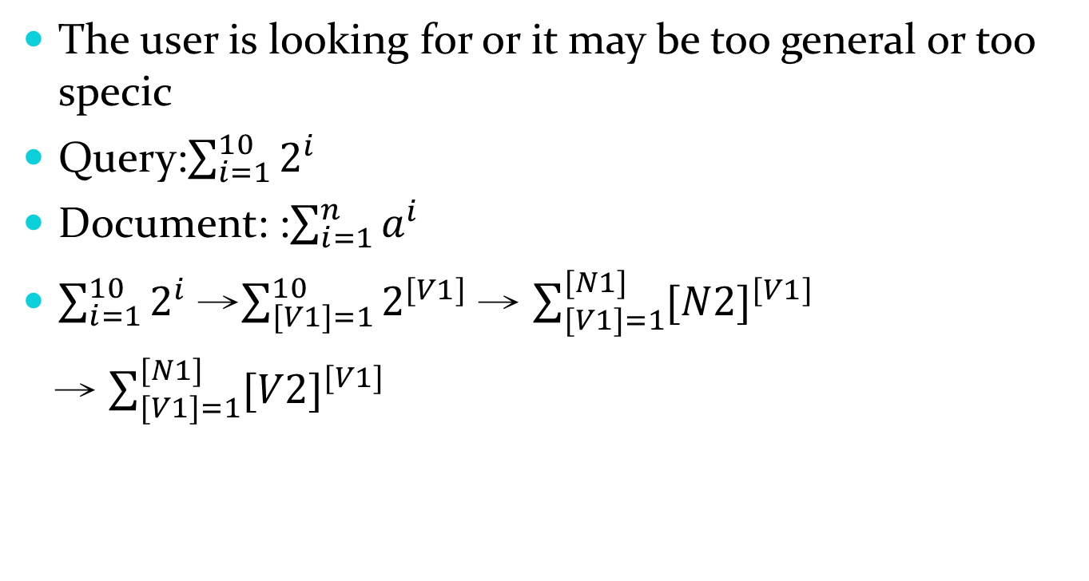
Feedback
The user is looking for or it may be too general or too specic
Query:$\sum_{i=1}^{10}{2^{i}}$
Document: :$\sum_{i=1}^{n}{a^{i}}$
$\sum_{i=1}^{10}{2^{i}}$ →$\sum_{[V1]=1}^{10}{2^{[V1]}}$ → $\sum_{[V1]=1}^{[N1]}{{[N2]}^{[V1]}}$
→ $\sum_{[V1]=1}^{[N1]}{{[V2]}^{[V1]}}$

Slide 20
Outline
Introduction
Method
Experiments
Conclusion

Slide 21
Experiment-Dataset
DLMF : Digital Library of Mathematics Functions

Slide 22
Evaluation measures
Consider top 10 result
NFR
MRR

Slide 23
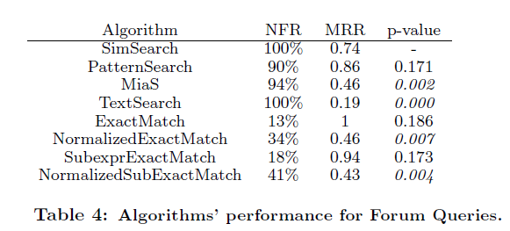
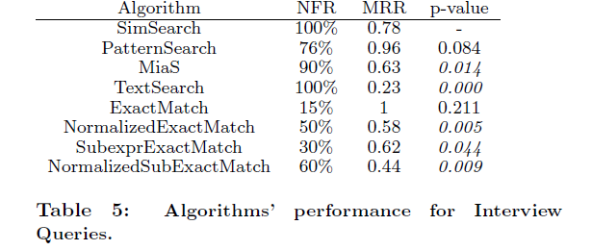
Results

Slide 24
Outline
Introduction
Methods
Experiments
Conclusions

Slide 25
Conclusions
categorize existing approaches to match mathematical expressions, concentrating on two paradigms that consider the structure of expressions
propose a representative system for each search paradigm

